Slide 1
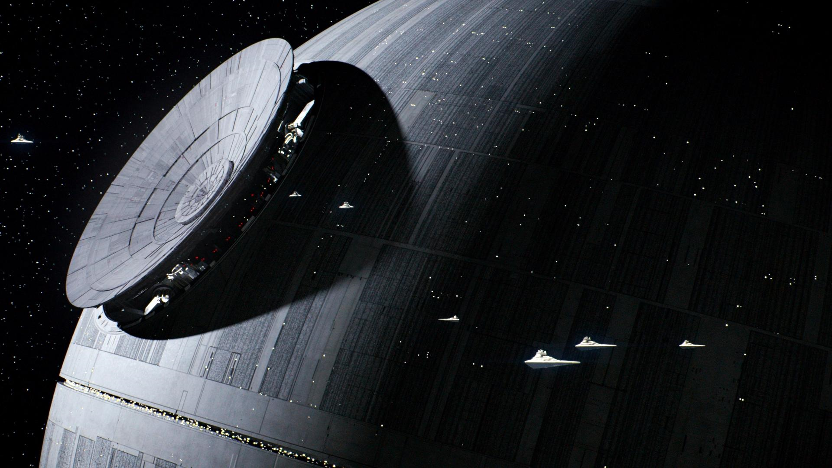
Gravitational Impact of the Death Star on Endor and Earth-like planets
Picture: https://i.redd.it/hzahguuq04cy.jpg
A Scientific Exploration Using Newtonian Mechanics
By: Simon Tebeck, Pranav Gupta
Team Name: The Skywalkers
PI: Prof. Oliver Beckstein
https://github.com/Py4Phy/final-2024-the-skywalkers
Notes:
Minimum 9 minutes
Good morning, everyone. Today, we will be presenting our findings from a simulation study on the gravitational effects of the Death Star, a massive space station, on its surrounding celestial bodies.

Slide 2
Background
Problem Statement: Investigate the gravitational impact of the Death Star on nearby celestial bodies like Earth and Endor.
Equations Used: Newton's Law of Universal Gravitation: F= GMm/r^2 Equations of Motion for Circular Orbits: F = ma Velocity Verlet
Motivation: Understanding these effects is crucial for predicting potential real-world outcomes in similar massive body interactions within a planetary system.
Notes:
> To set the stage, let's discuss why this study is important. The Death Star, as depicted in popular media, is an enormous structure capable of influencing gravitational fields. Using Newton’s Law of Universal Gravitation and equations of motion, we explored its potential impacts on planetary bodies.
> This study not only satisfies scientific curiosity but also helps in understanding how large artificial satellites could affect their environment

Slide 3
Methods
‘Many-Body-Problem’
Algorithms: Velocity Verlet Integration for accurate motion simulation. Similar to previous work
Main Libraries Used: NumPy for numerical operations Matplotlib for plotting and animations Moviepy for creating videos
Surface Impacts: Simulate many probe masses on the globe and calculate acting forces
Notes:
> Our approach involved several key steps. We used the Velocity Verlet integration algorithm for precise motion simulation, considering the masses and distances of Earth, its moon, Endor, and the Death Star.
> We performed these calculations using Python, with libraries like NumPy for numerical operations and Matplotlib for visualization.
> Here's a brief snippet of our code, demonstrating how we applied Newton's gravitational formula to update the velocities and positions of each celestial body in our simulation.

Slide 4
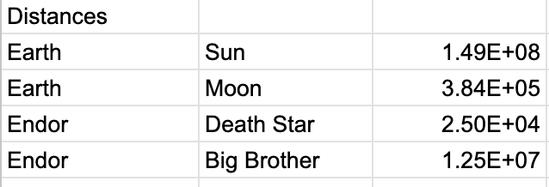
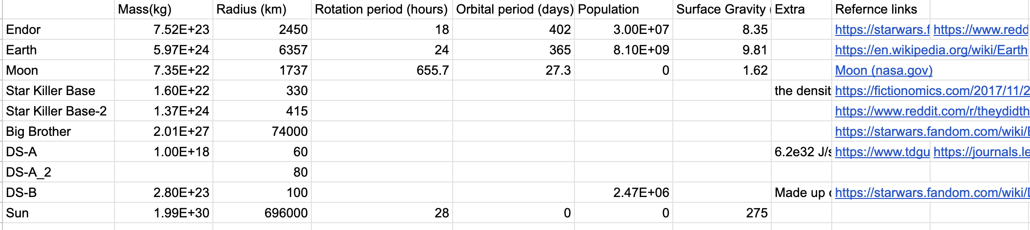
Results - Task 1: Data Collection
Collected the required information form fan pages, reddit and publicly available data for Masses, distances,
Notes:
> We collected mass, radius and other available data on endor, star killer base, death star, big brother tana, earth, moon, and sun.

Slide 5
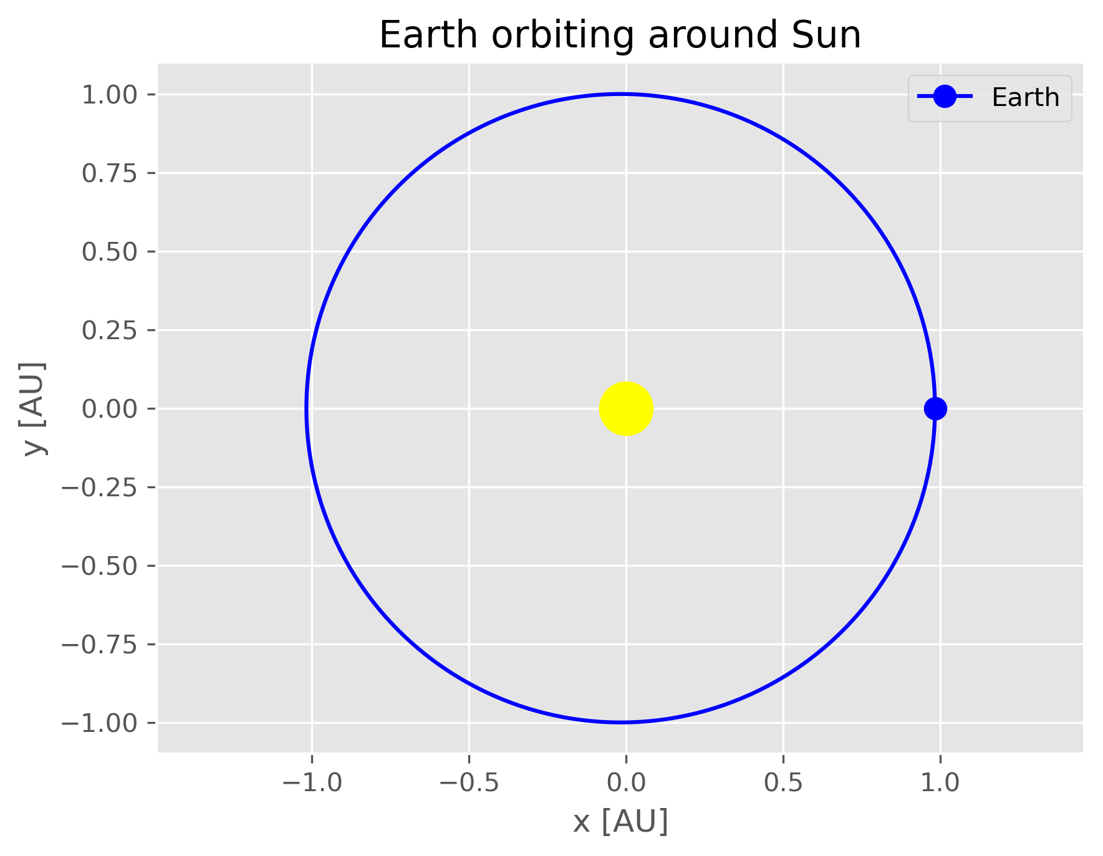
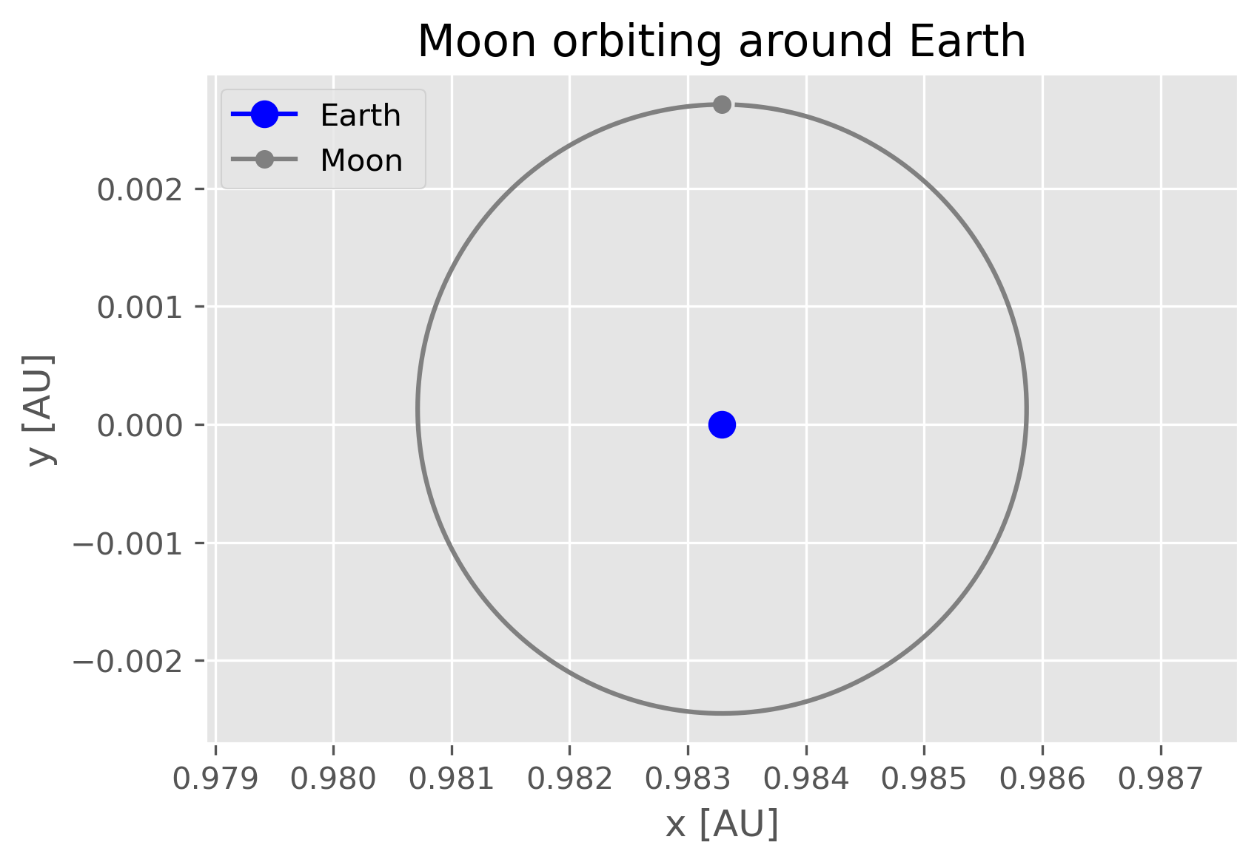
Results – Task 2: Orbits
Control Orbits
Notes:
> We collected mass, radius and other available data on endor, star killer base, death star, big brother tana, earth, moon, and sun.

Slide 6
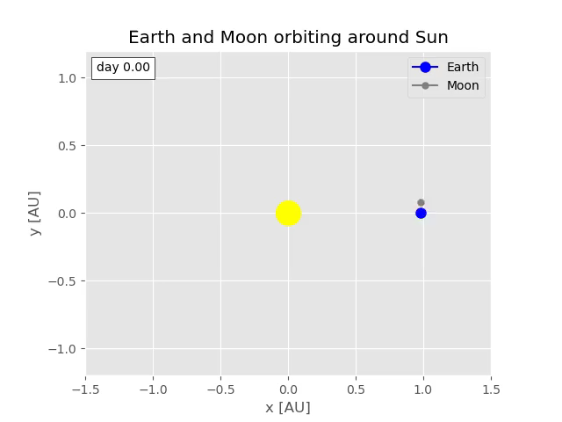
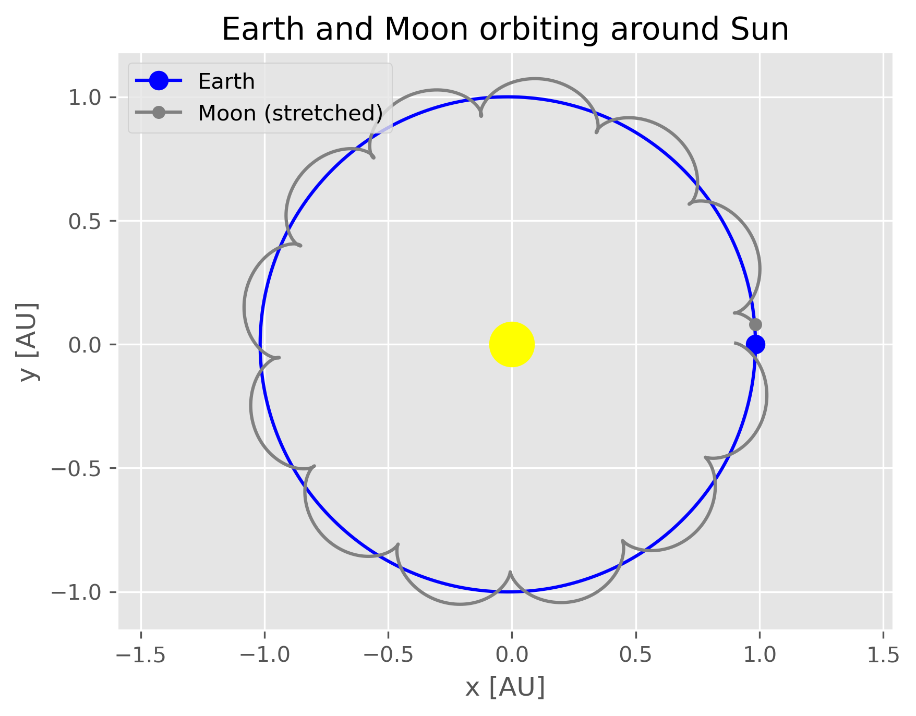
Results – Task 2: Orbits
Control Orbits
Notes:
> We collected mass, radius and other available data on endor, star killer base, death star, big brother tana, earth, moon, and sun.

Slide 7
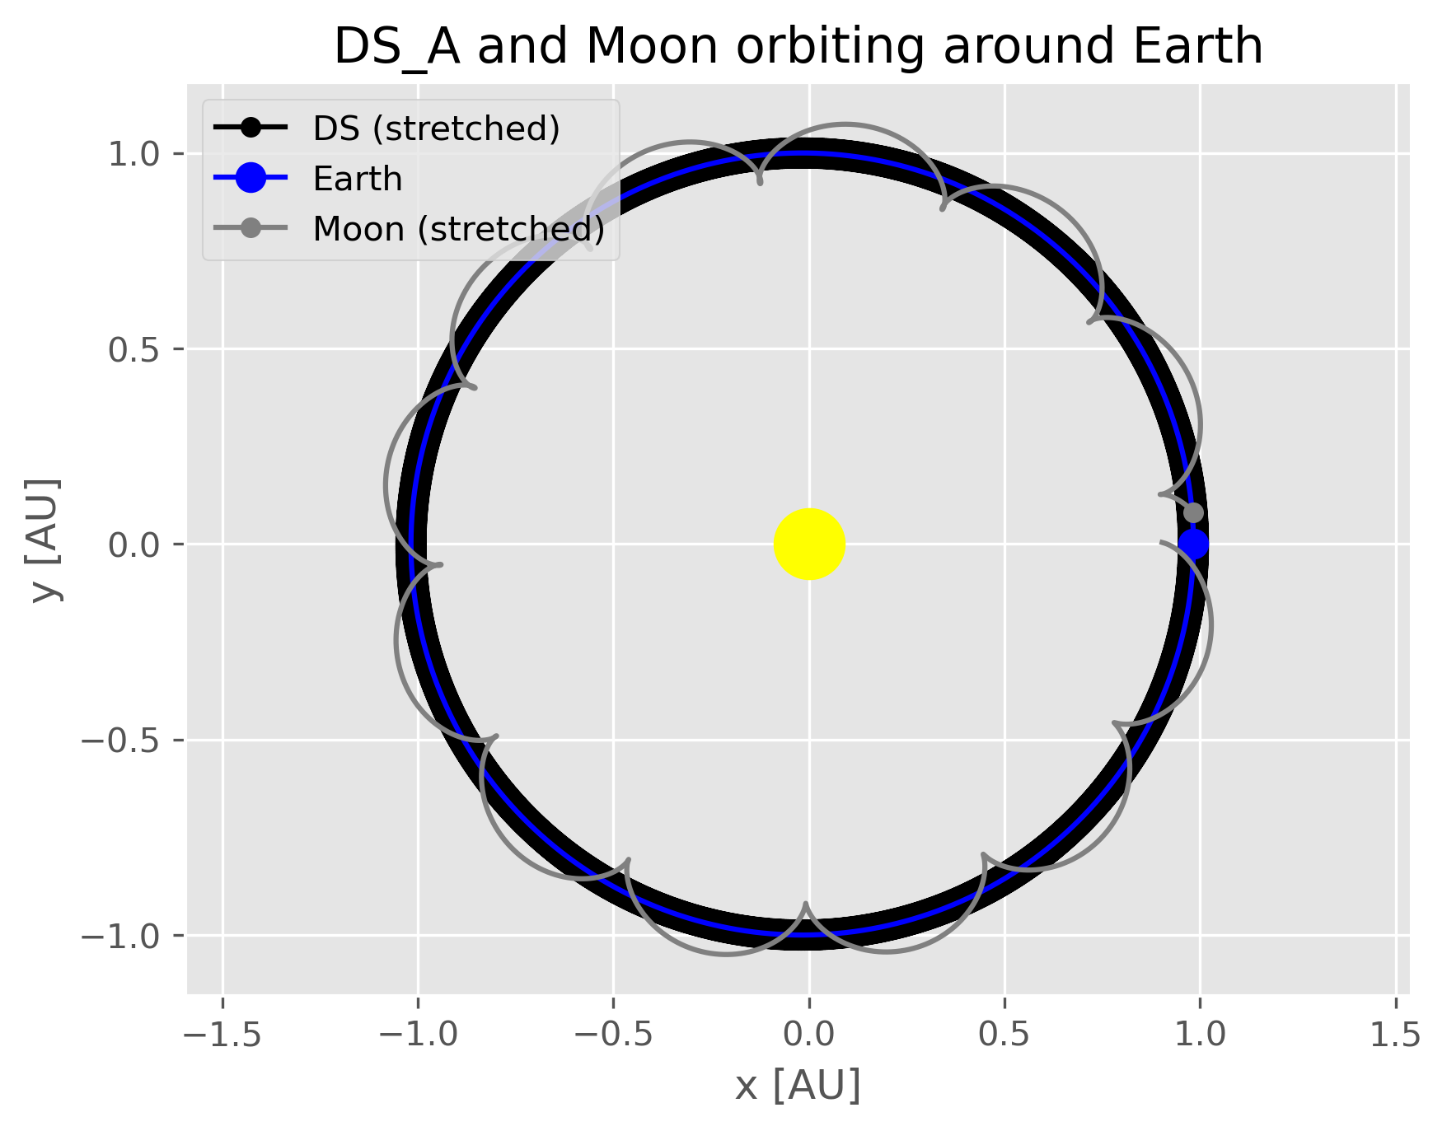
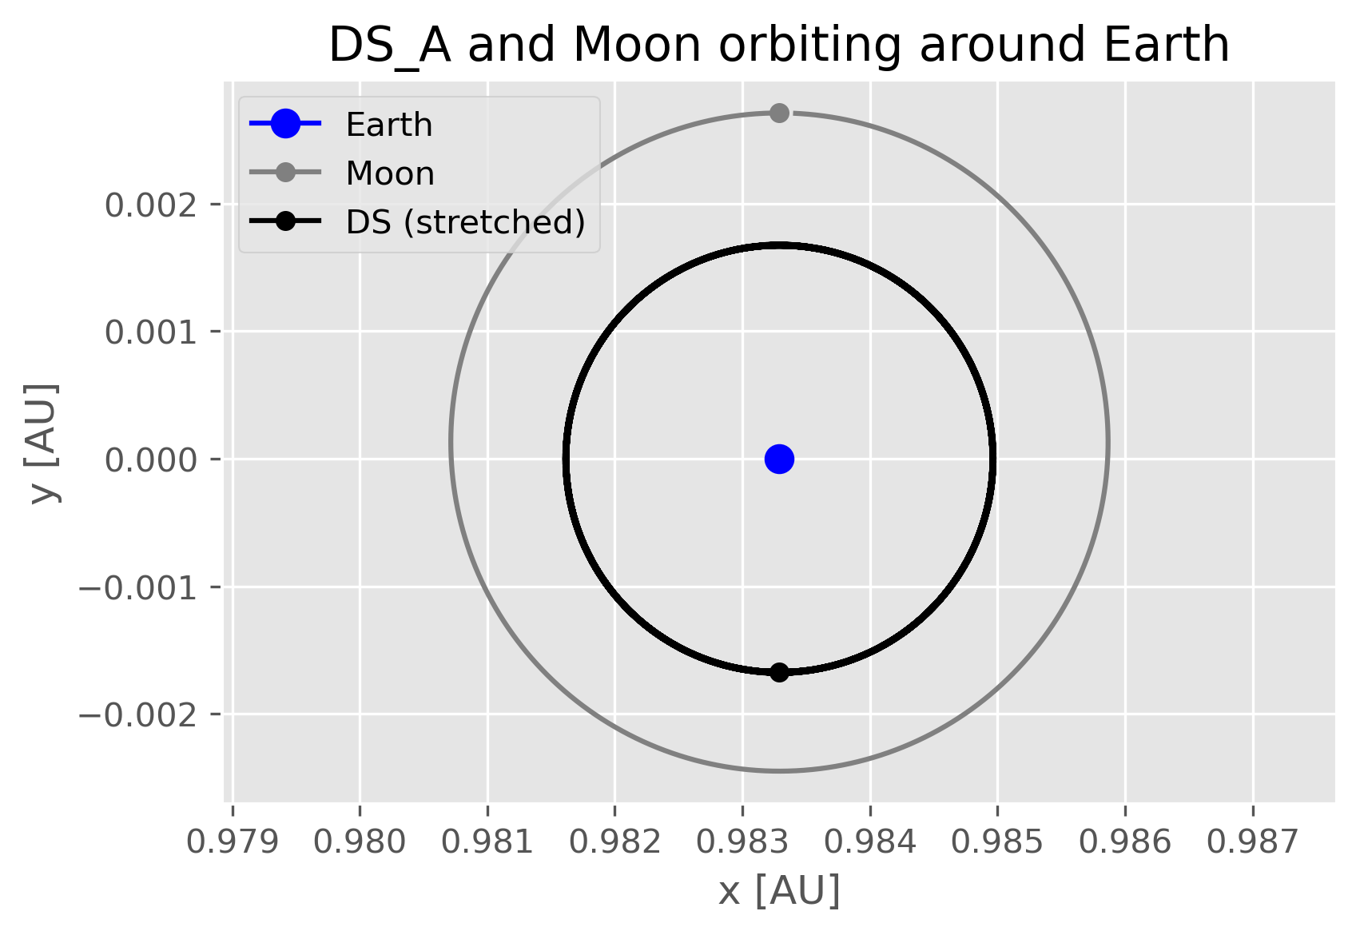
Results – Task 2: Orbits
Orbits with the light Death Star
Notes:
> We collected mass, radius and other available data on endor, star killer base, death star, big brother tana, earth, moon, and sun.

Slide 8
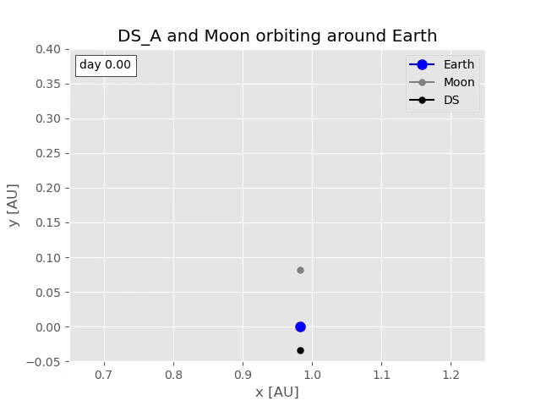
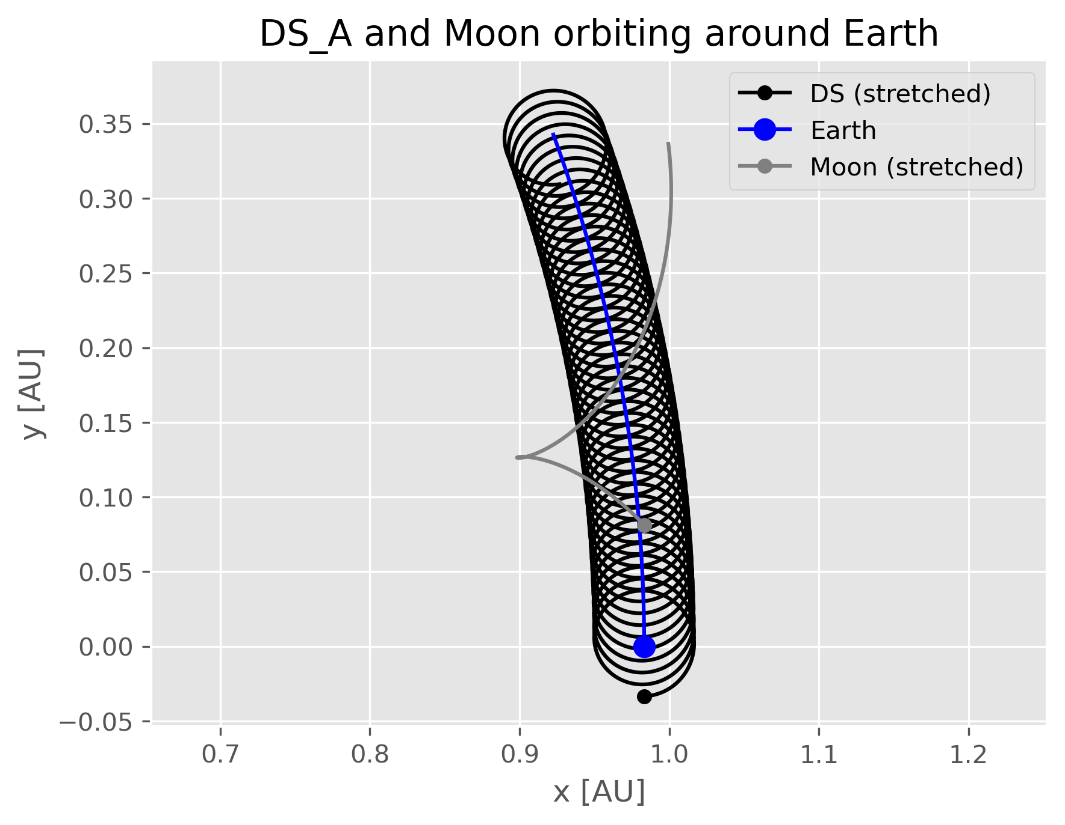
Results – Task 2: Orbits
Orbits with the light Death Star
Notes:
> We collected mass, radius and other available data on endor, star killer base, death star, big brother tana, earth, moon, and sun.

Slide 9
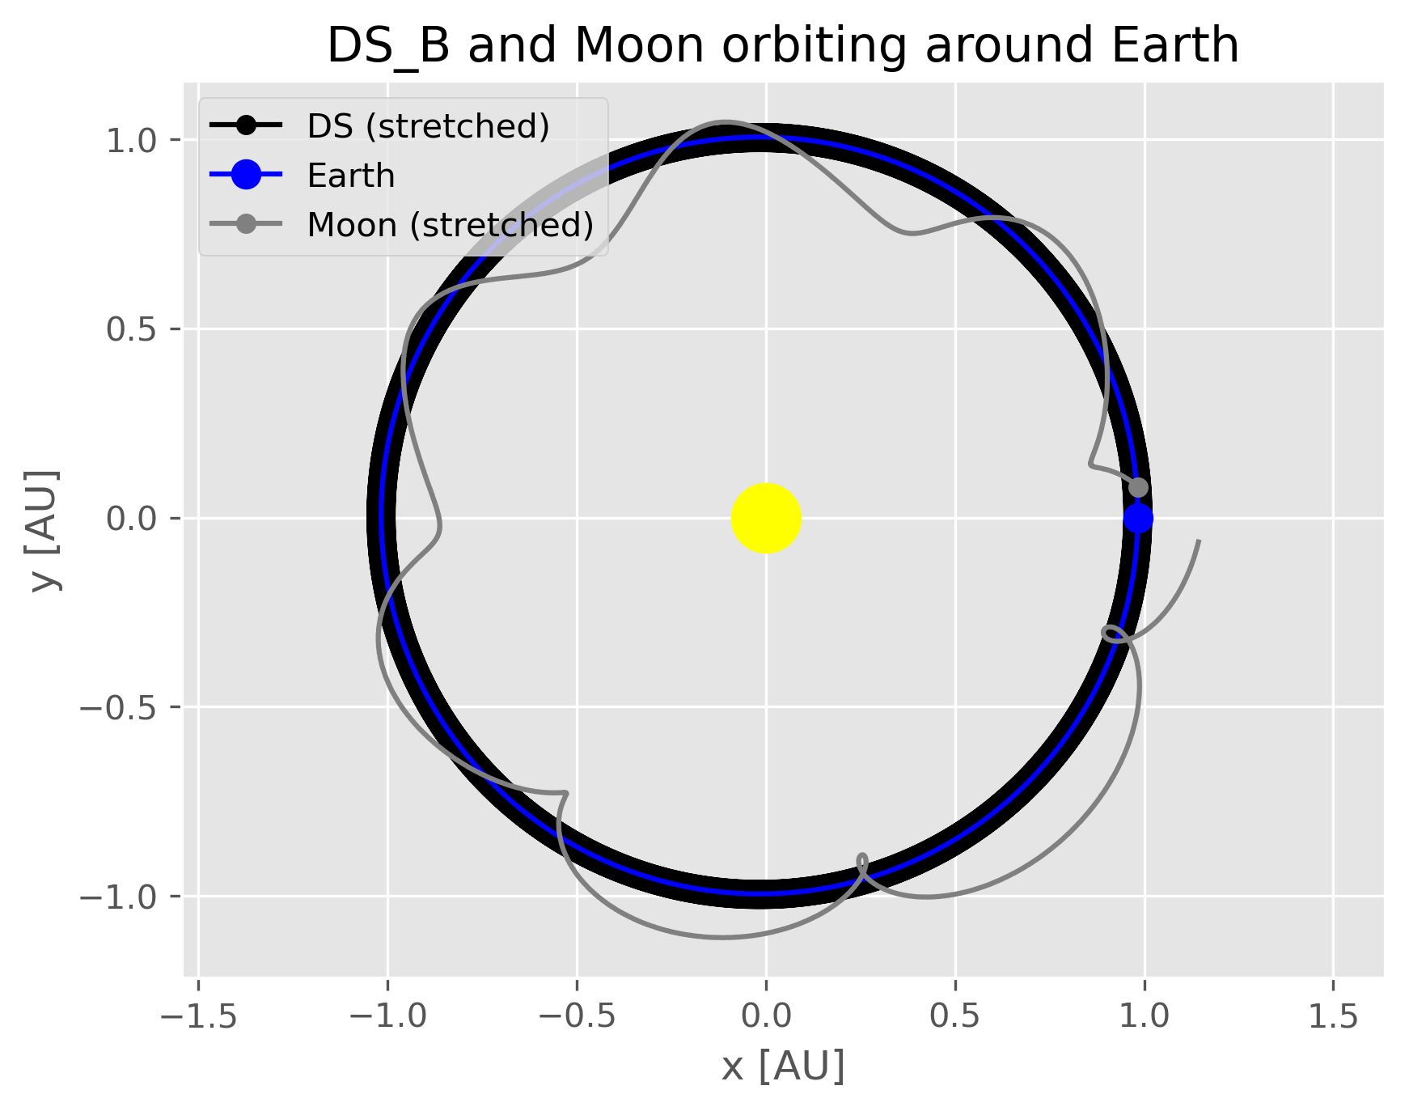
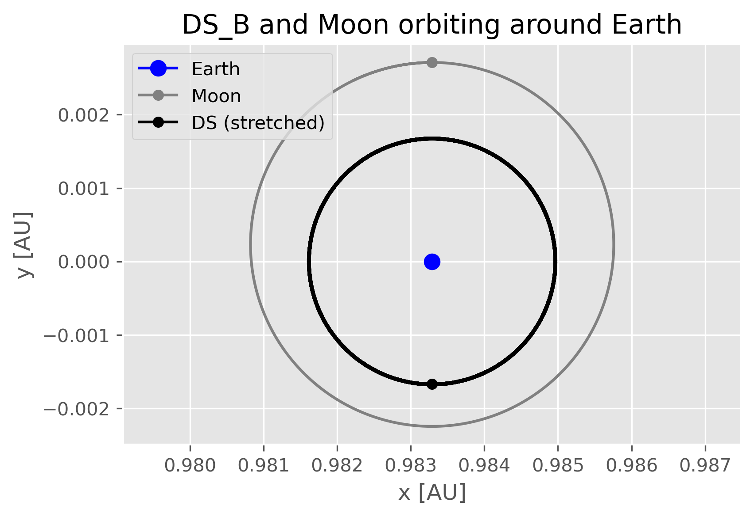
Results – Task 2: Orbits
Orbits with the heavy Death Star
Notes:
> We collected mass, radius and other available data on endor, star killer base, death star, big brother tana, earth, moon, and sun.

Slide 10
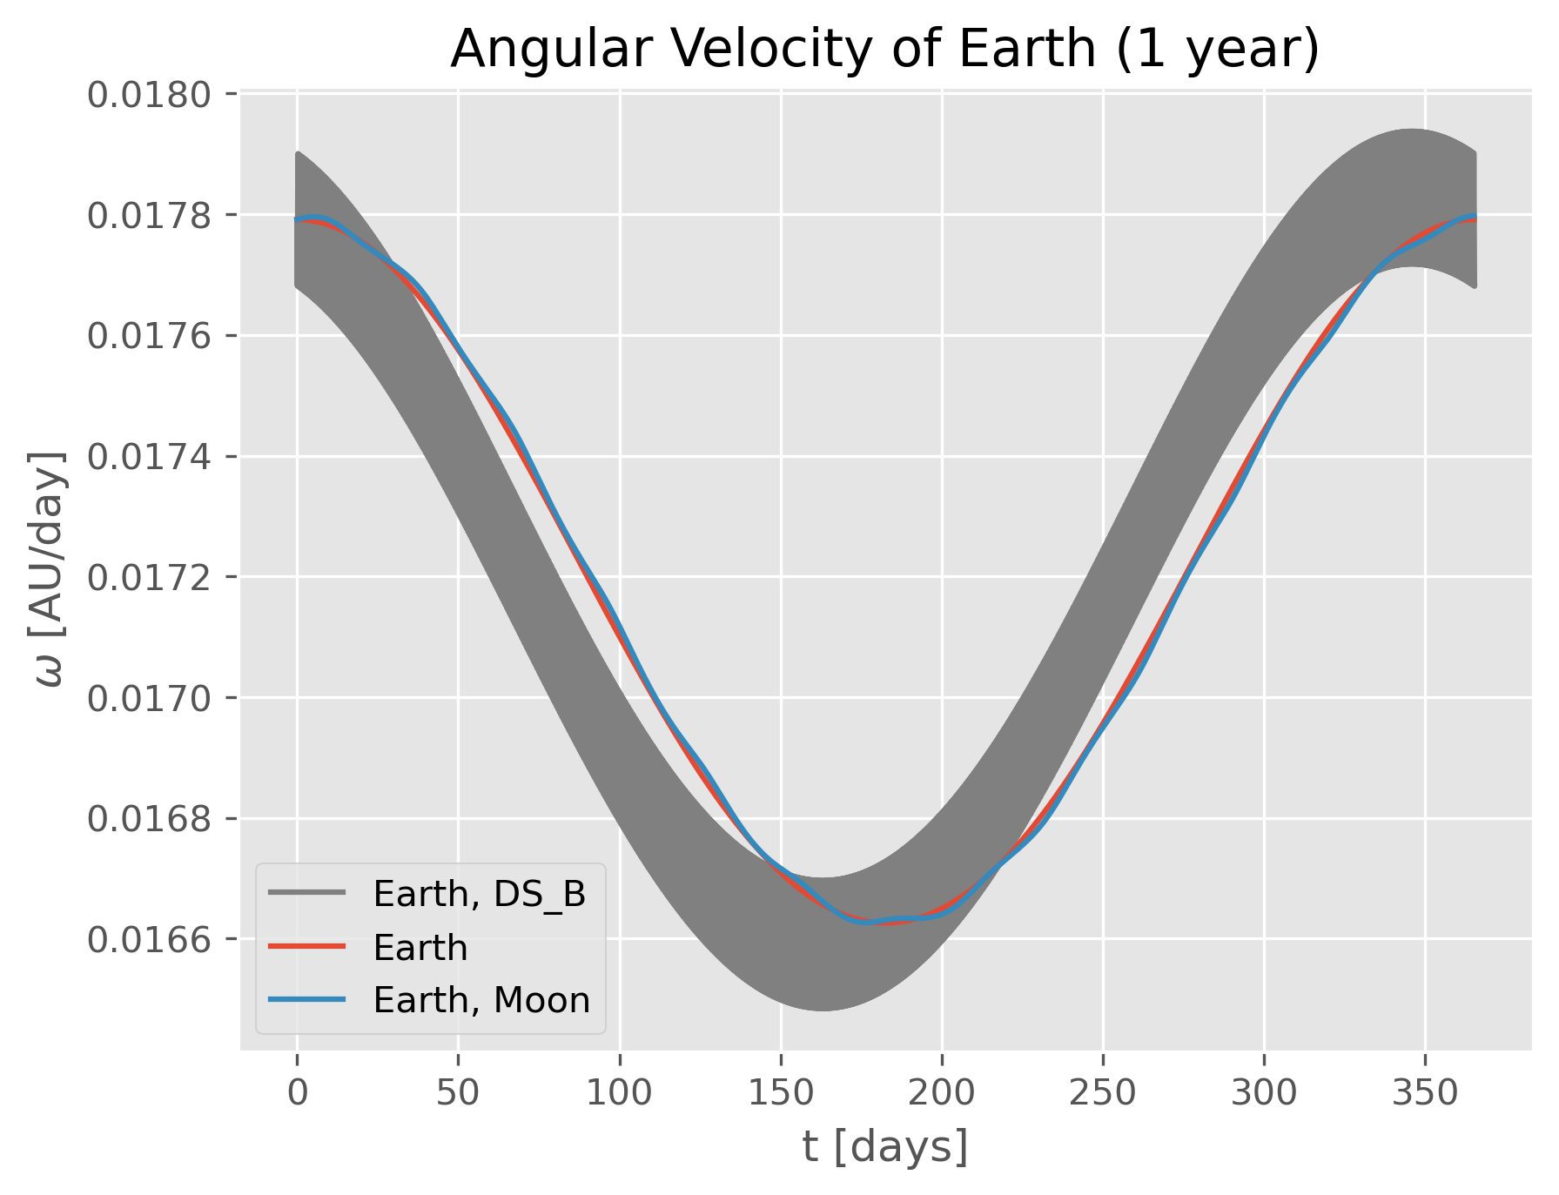
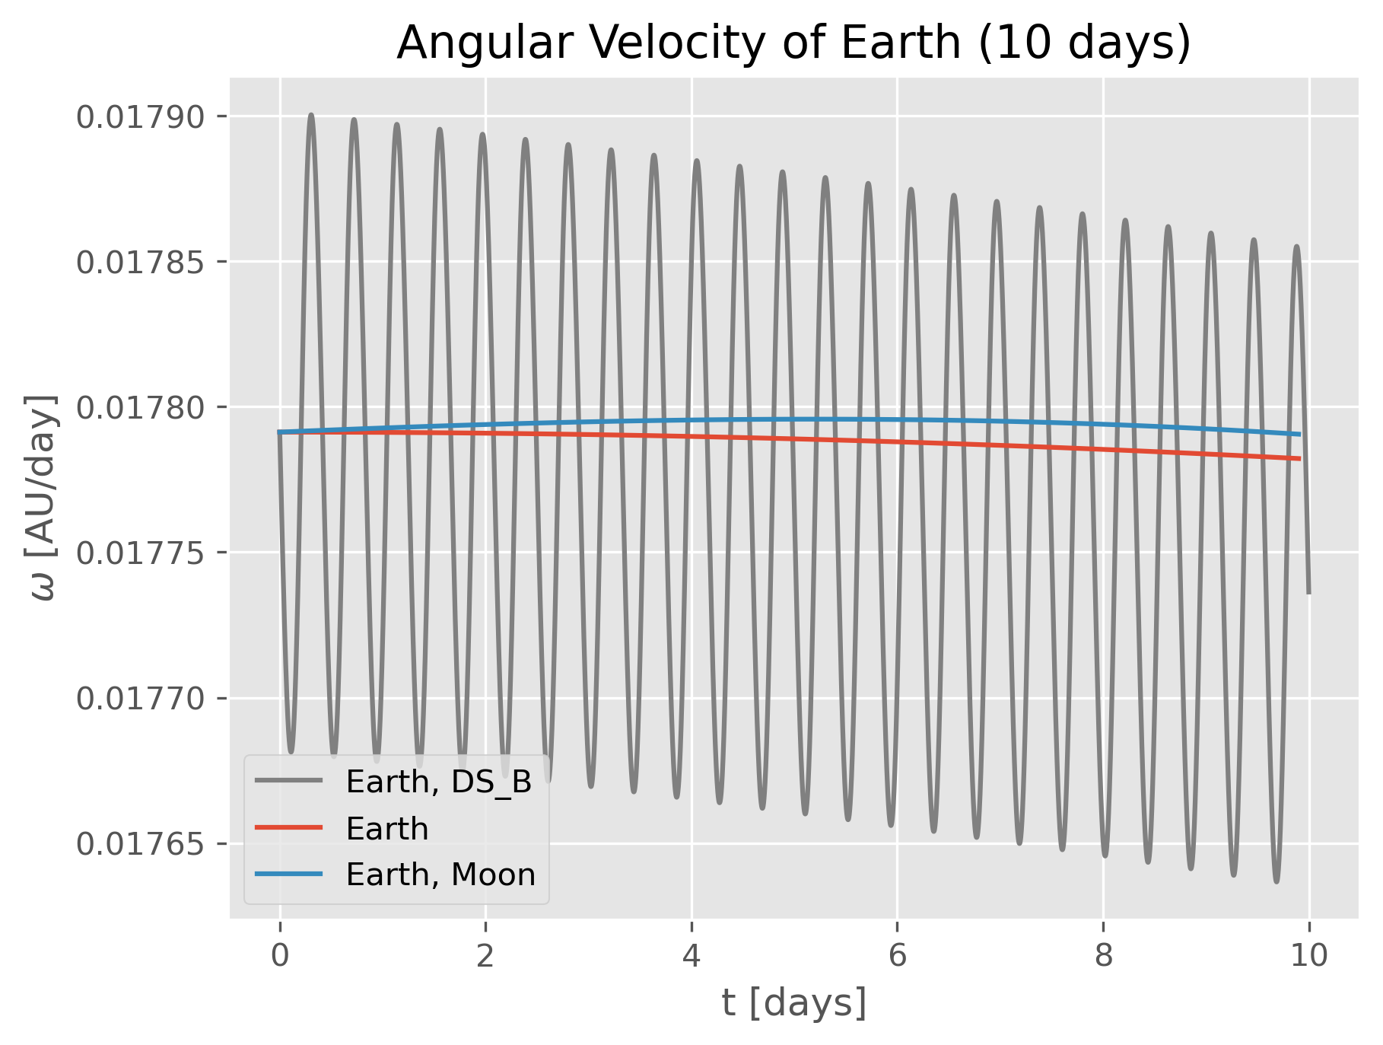
Results – Task 2: Orbits
Angular Velocity Impacts
Notes:
> We collected mass, radius and other available data on endor, star killer base, death star, big brother tana, earth, moon, and sun.

Slide 11
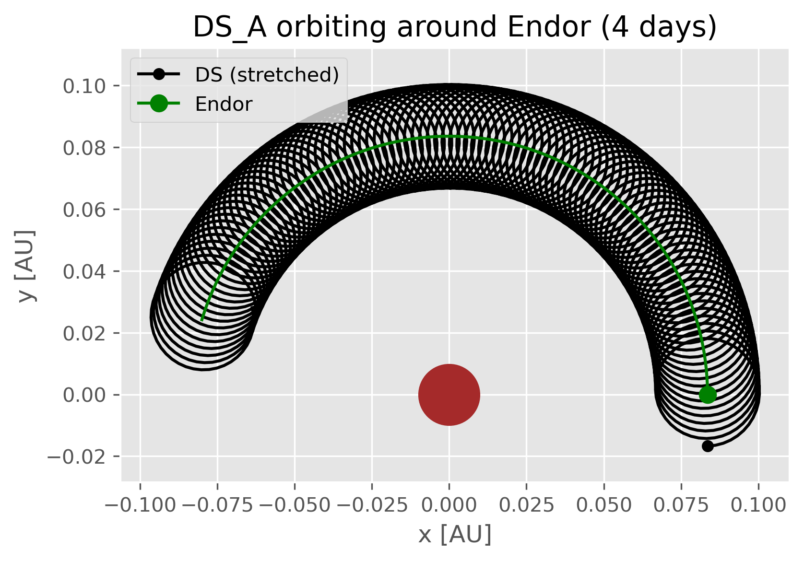
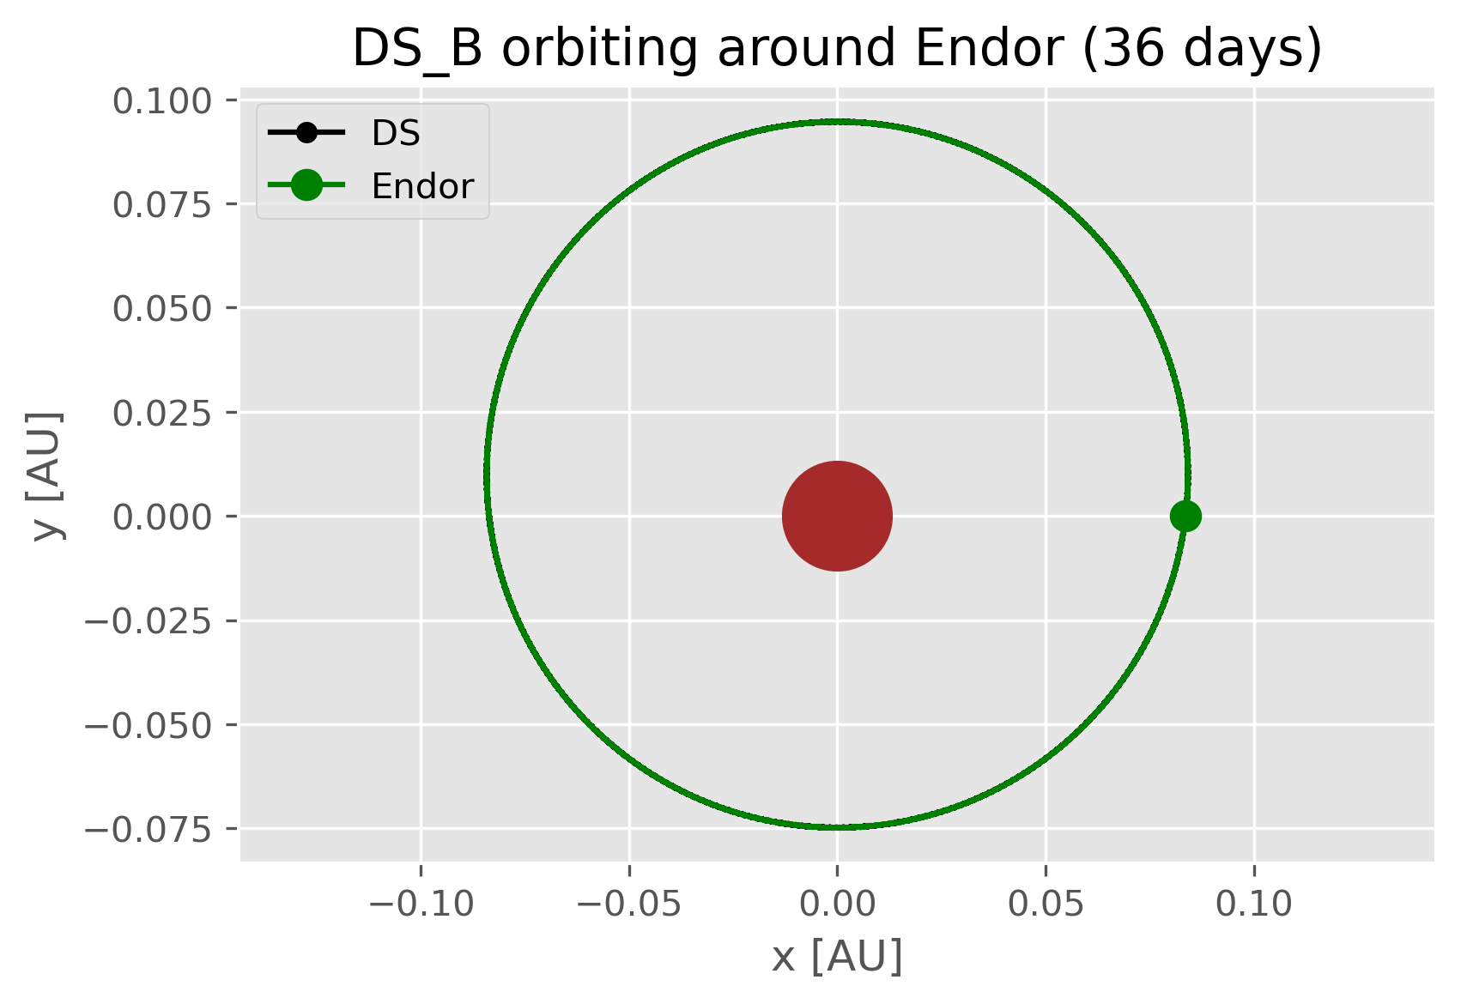
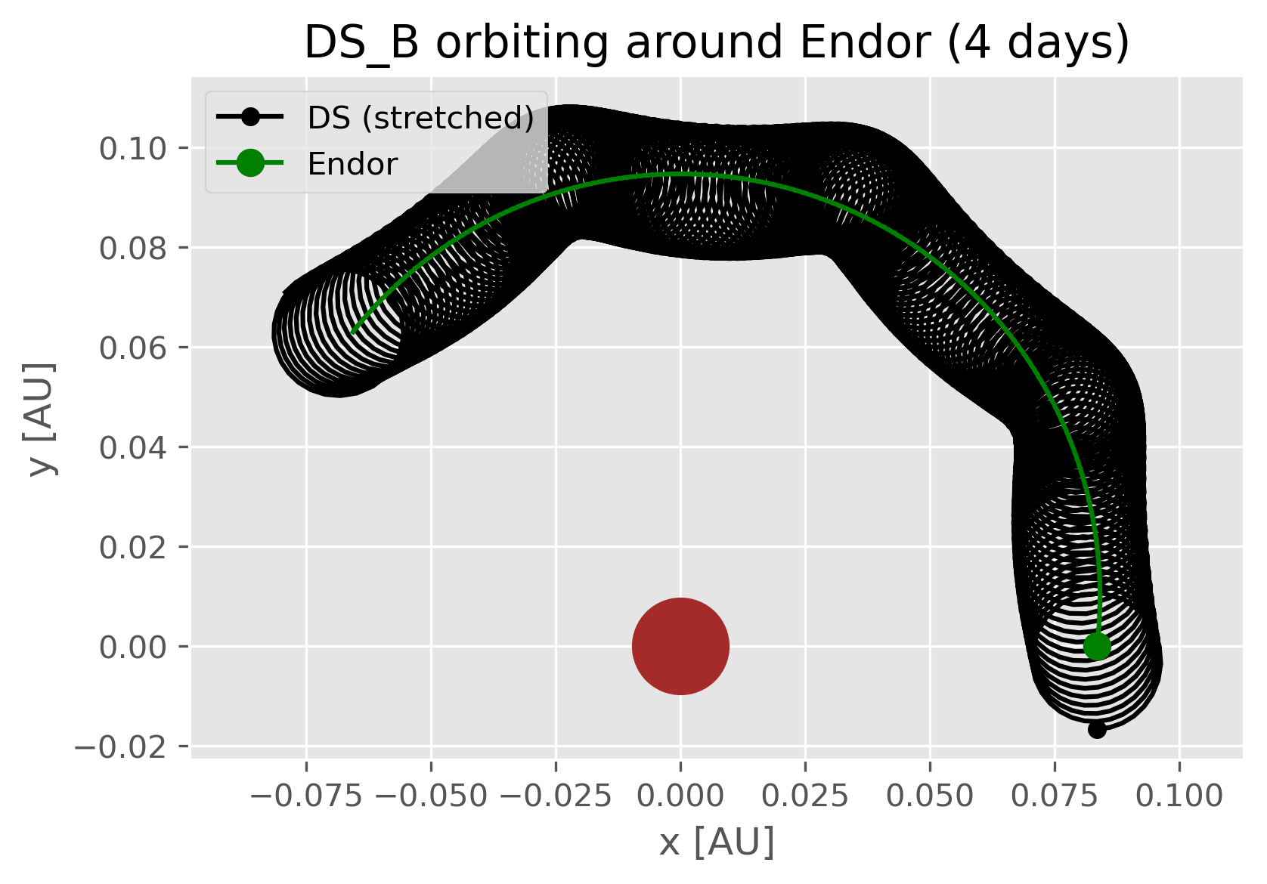
Results – Task 2: Orbits
Orbits for Endor
Notes:
> We collected mass, radius and other available data on endor, star killer base, death star, big brother tana, earth, moon, and sun.

Slide 12
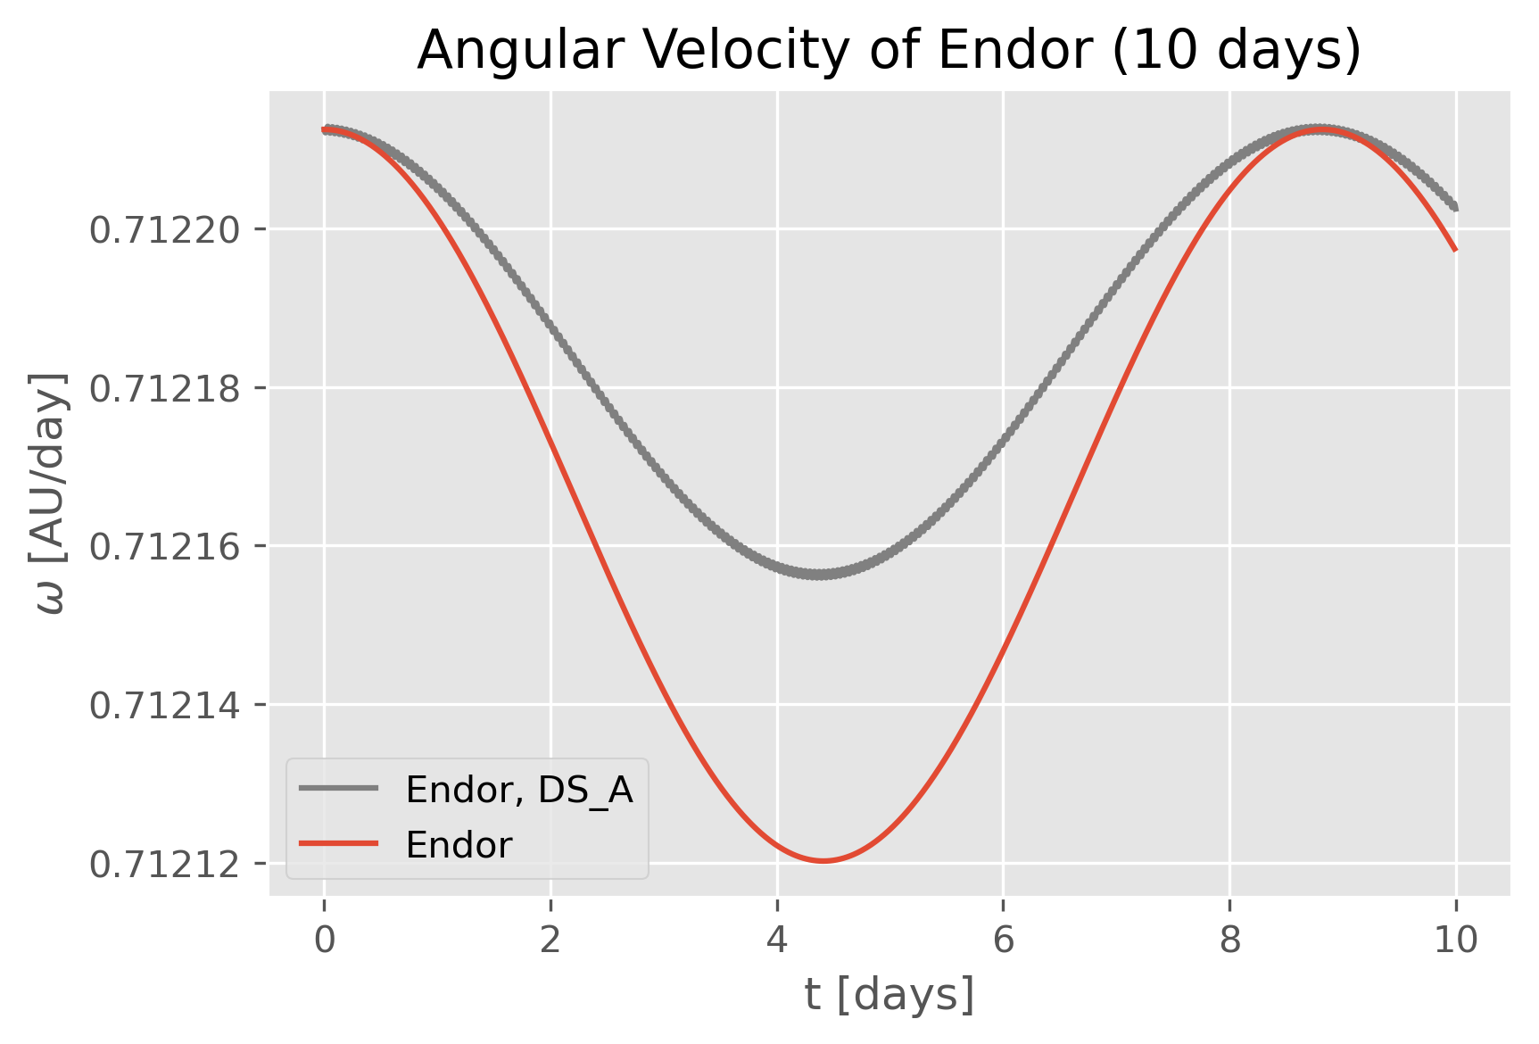
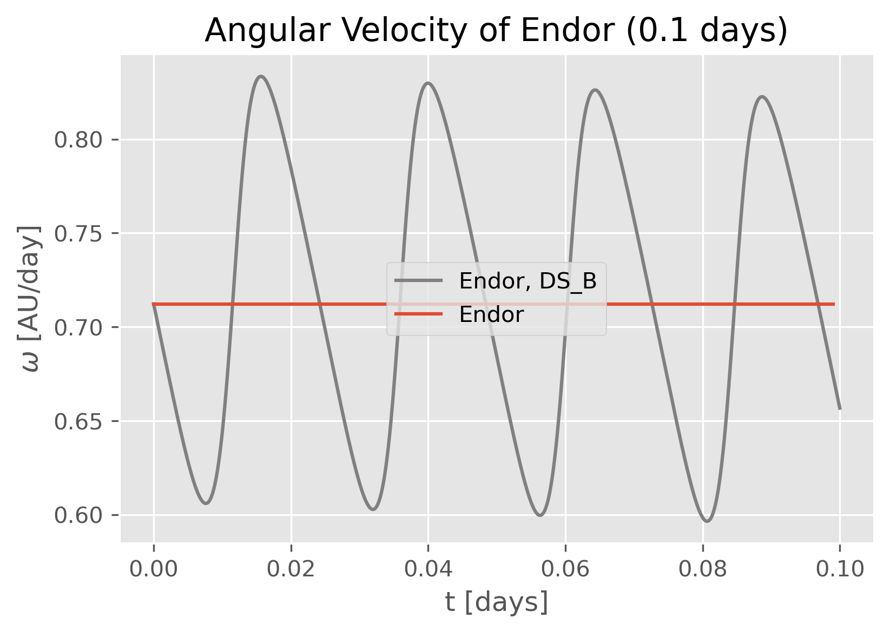
Results – Task 2: Orbits
Angular Velocities for Endor
Notes:
> We collected mass, radius and other available data on endor, star killer base, death star, big brother tana, earth, moon, and sun.

Slide 13
Results – Task 2: Orbits
Period Deviations
 | Earth | Moon | Endor
Period [days] Normal conditions | 365.37 | 27.44 | 8.82
Period [days] DS_A impact | 365.37 | 27.44 | 8.82
Period [days] DS_B impact | 365.34 | 25.24 | 9.00
Deviation of DS_B impact to normal | 0.009% | 8.00% | 2.04%
Notes:
> We collected mass, radius and other available data on endor, star killer base, death star, big brother tana, earth, moon, and sun.

Slide 14
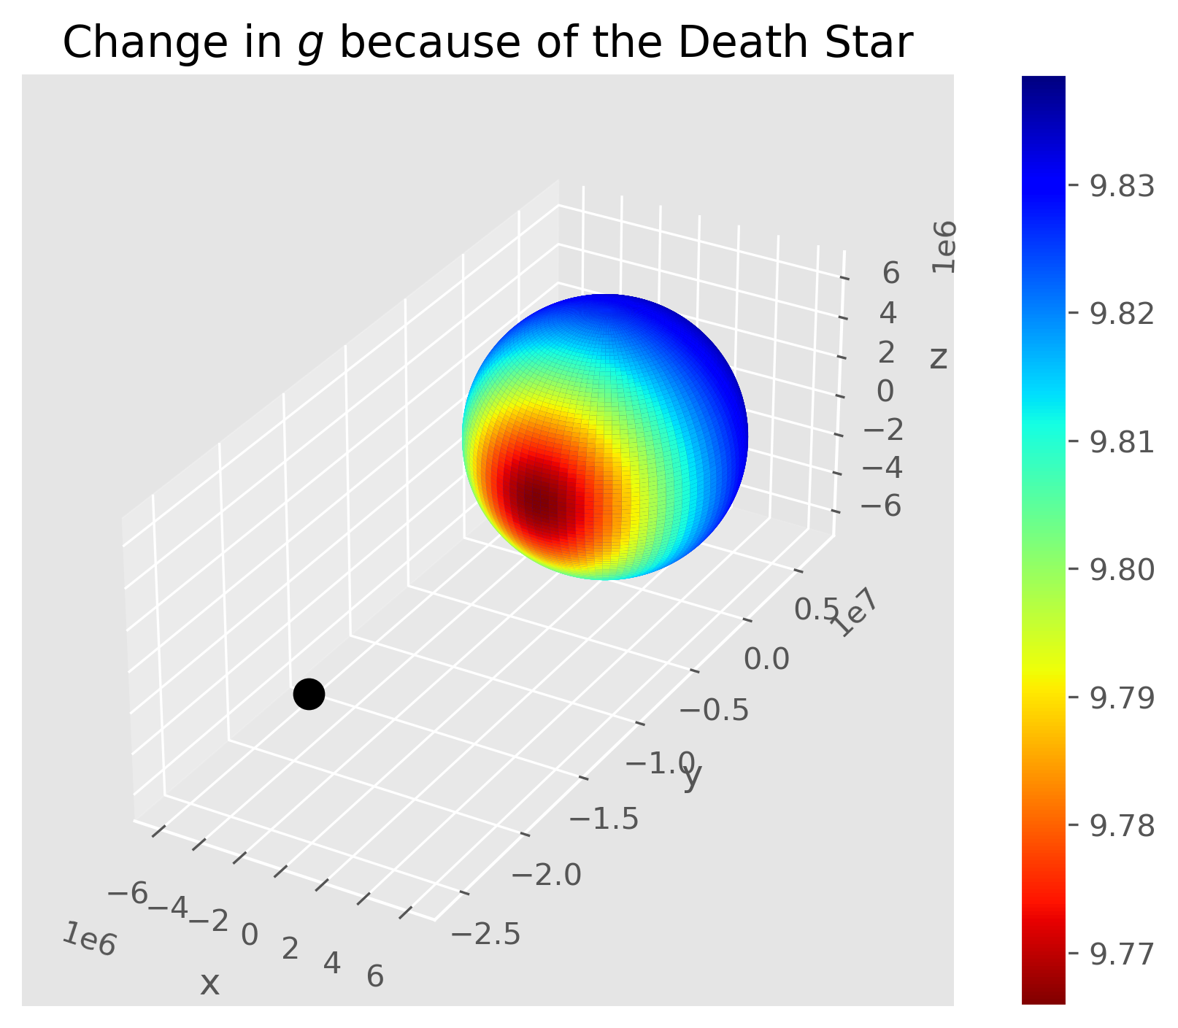
Results – Task 3: Surface Impacts
Reduction of local gravitational acceleration
The gravitational pull of Death Star (B) reduces the local gravitational acceleration on Earth
Value can go as low as 9.756 m/s²
Pull is three orders of magnitude stronger than Moon’s
Notes:
> We collected mass, radius and other available data on endor, star killer base, death star, big brother tana, earth, moon, and sun.

Slide 15
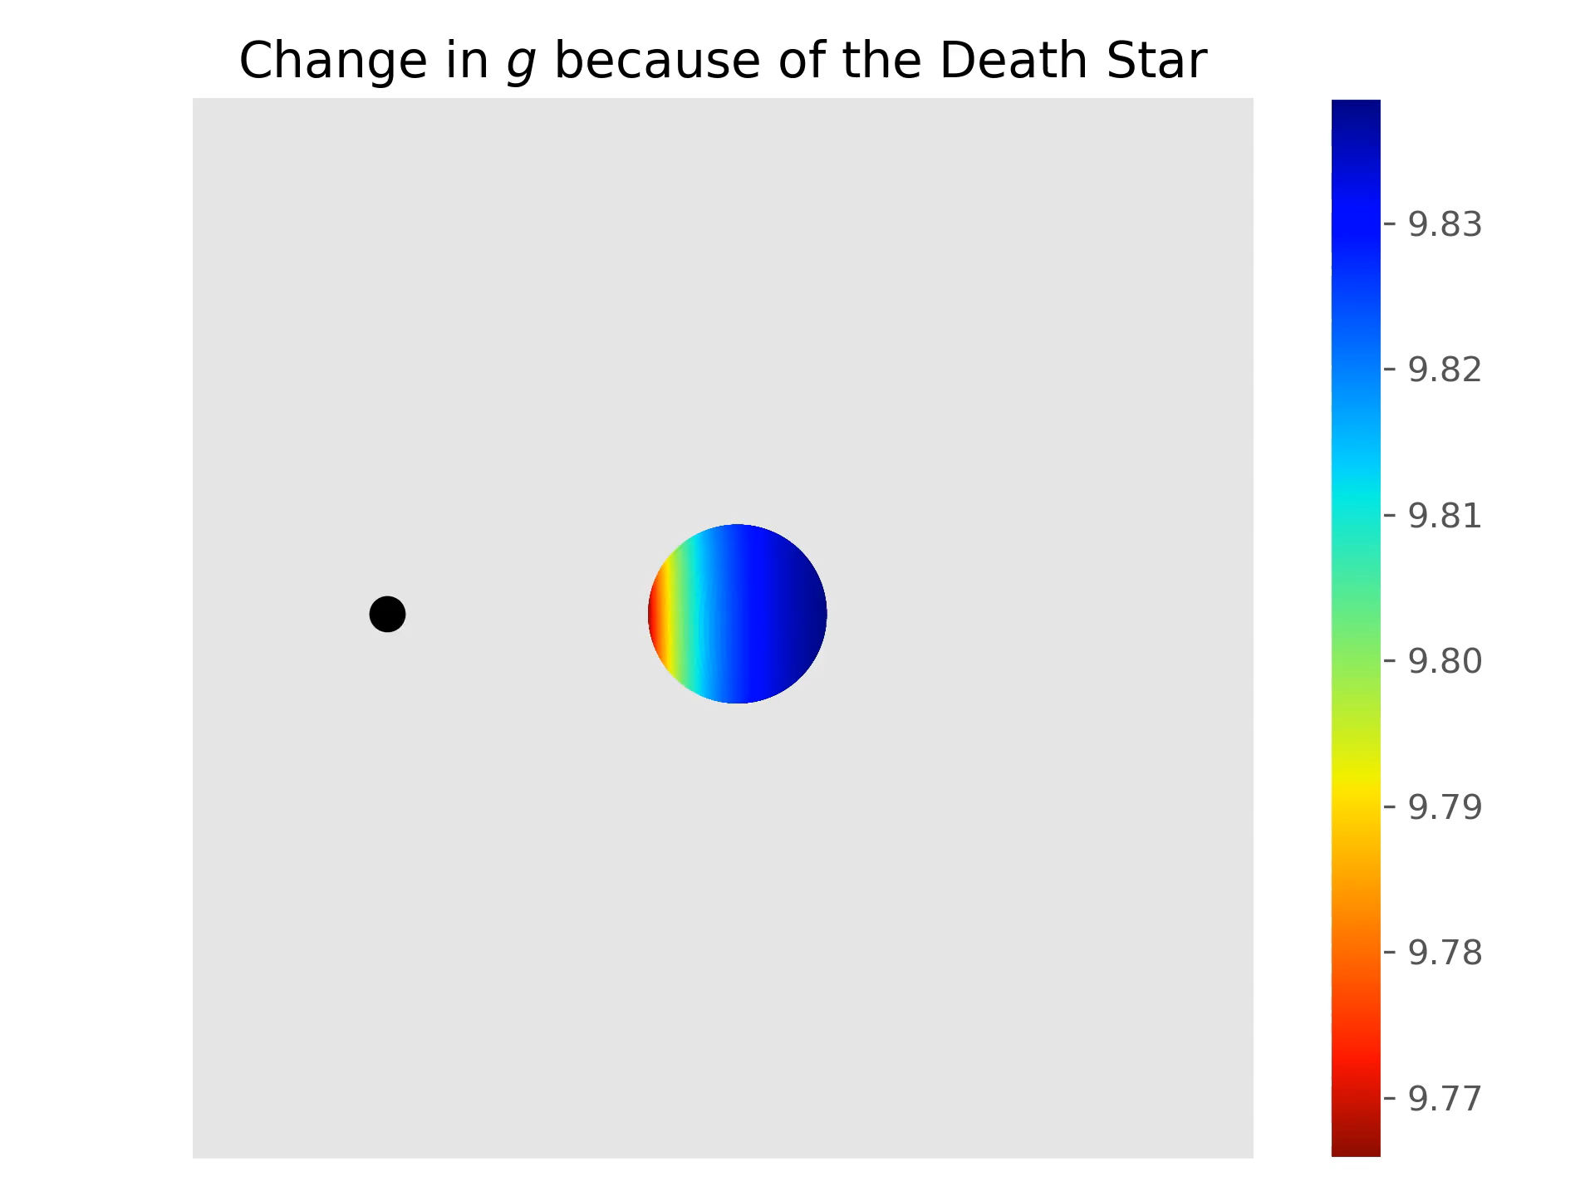
Results – Task 3: Surface Impacts
Reduction of local gravitational acceleration
Notes:
> We collected mass, radius and other available data on endor, star killer base, death star, big brother tana, earth, moon, and sun.

Slide 16
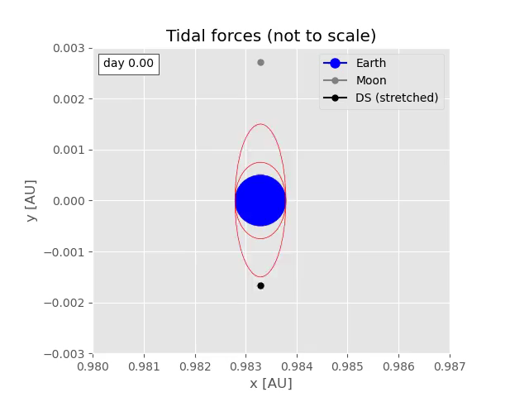
Results – Task 3: Surface Impacts
Tidal effects
Estimation of tidal effects based on the gravitational differential
The mass and proximity of the Death Star create huge tidal forces which are four orders of magnitude bigger than Moon’s (for DS_B)
We have to expect waves on the ocean with heights of around 3.7 km, even higher ones on the coast
 | Tidal effect [m/s²]
Moon | 1.873e-06
Sun | 1.063e-6
DS_A | 1.245e-7
DS_B | 3.486e-2
Notes:
> We collected mass, radius and other available data on endor, star killer base, death star, big brother tana, earth, moon, and sun.

Slide 17
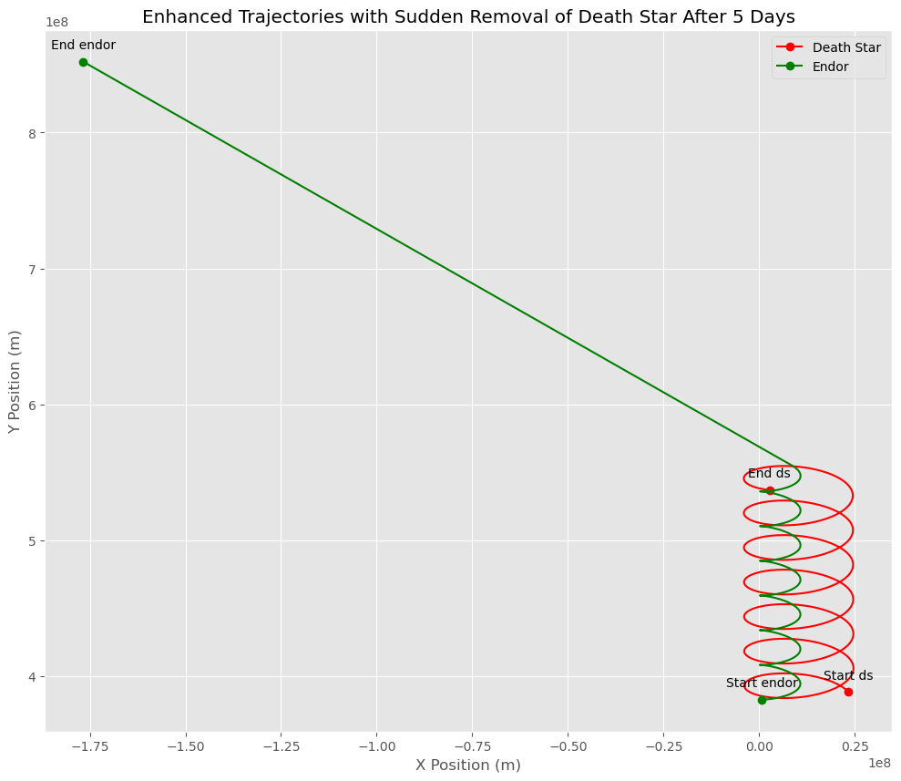
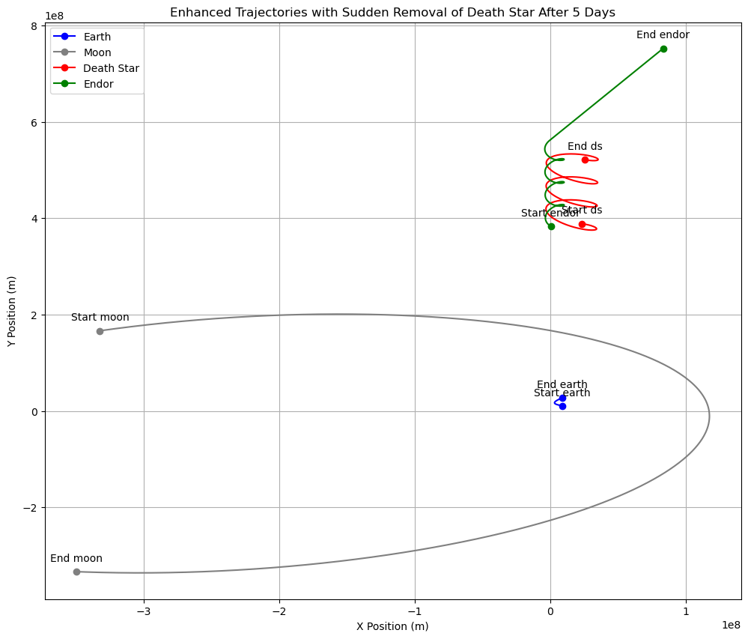
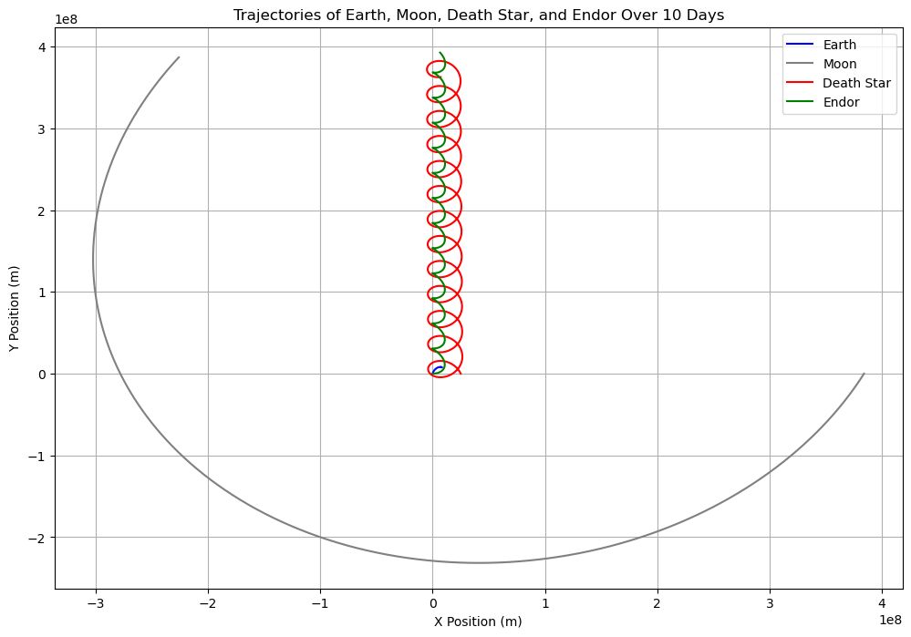
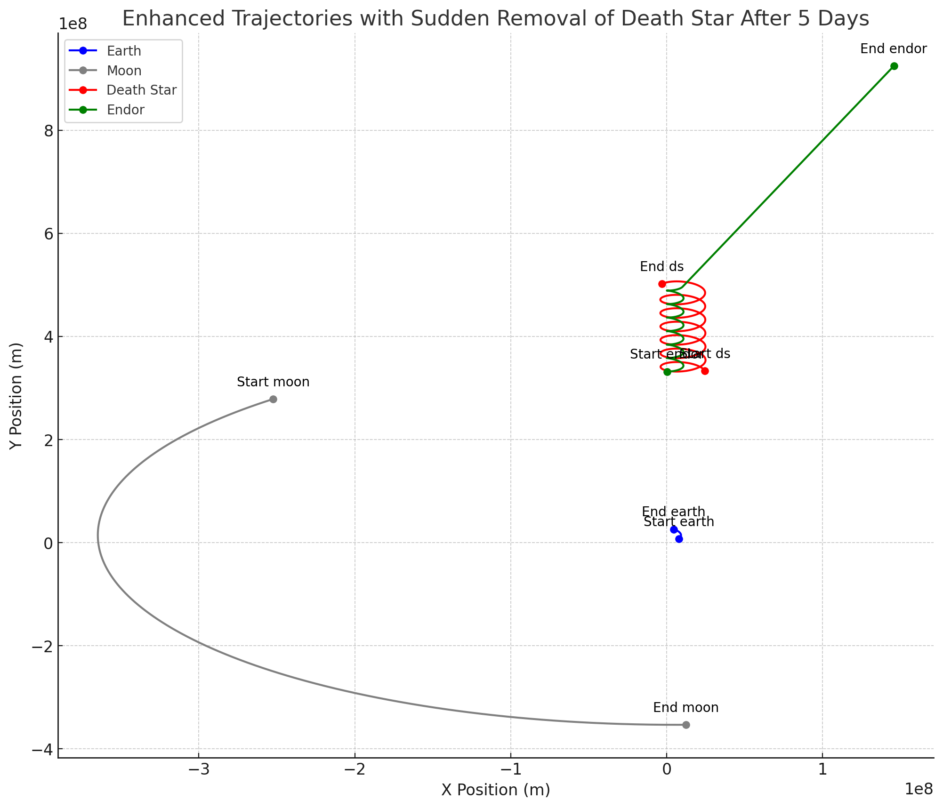
Results - Task 4: Sudden Disappearance
Implications of Death Star's Sudden Disappearance
The sudden removal of the Death Star leads to a destabilization of Endor's and Earth's orbit, demonstrating the significant gravitational influence exerted by the Death Star.
Notes:
> Finally, we explored what happens when such a massive body suddenly disappears. The trajectories post-removal show a temporary destabilization in Endor’s orbit, illustrating the abrupt removal of a significant gravitational pull.
> This scenario is crucial for understanding the dynamics of systems undergoing sudden mass loss.

Slide 18
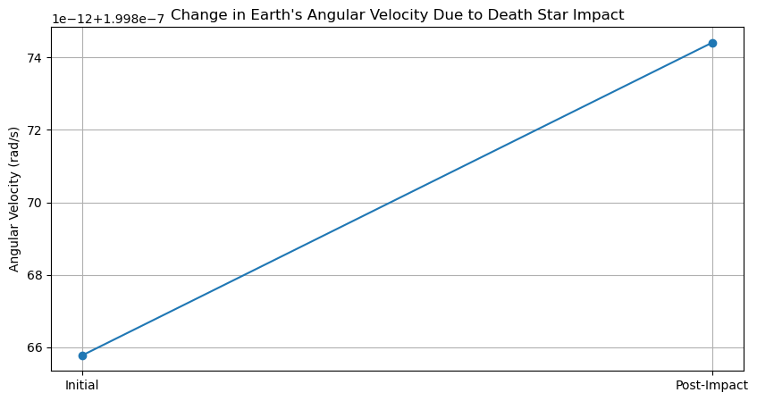
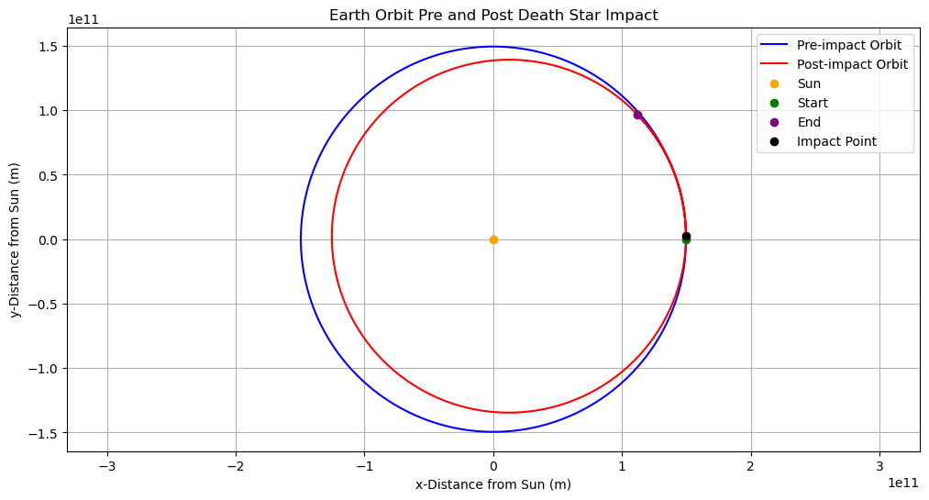
Results - Task 4: Sudden Disappearance
Implications of Death Star's Sudden Disappearance
The sudden crash of the Death Star leads to a significant reduction in Earth's distance from the Sun with higher angular and orbital velocity.
Notes:
We started by modeling Earth’s orbit around the Sun, considering Earth’s original mass and its increased mass post-impact when death star crashes with earth at same speed and in same direction, conserving momentum we calculated the new earth velocity by adding the Death Star’s mass to Earth. . This allowed us to observe not just the shift in the orbital path but also changes in Earth's angular velocity and kinetic energy.
The results were quite revealing. Our plots, which you see on the screen, illustrate distinct differences in Earth's orbit pre and post-impact, highlighting a noticeable shift in trajectory. Another graph shows a significant change in angular velocity, indicating an alteration in Earth’s rotational speed due to the increased mass. As shown in the diagram on this slide, the new orbit is much closer to the Sun, which would likely lead to extreme increases in temperature and radiation, rendering Earth uninhabitable. while the scenario is fictional, it offers a profound lesson on the sensitivity of our planet's orbital mechanics to changes in mass and gravitational forces. It's a stark reminder of how cosmic events could potentially disrupt or even devastate planetary systems.

Slide 19
Conclusions
The simulation showed significant gravitational effects of the Death Star, especially the heavy estimation, on nearby planets, altering their trajectories and potentially causing orbital destabilization.
Period times change because of the Death Star, slightly for big objects like Earth, but significantly for smaller objects like the Moon or Endor
On Earth, the heavy Death Star would create monstrous tides and kilometer-high waves on the ocean
Demonstrated how the sudden removal of a massive body affects planetary systems.
The simulation confirmed that the Death Star’s crash would lead to substantial modifications in Earth's orbital and kinetic energy.
Notes:
> To conclude, our study has shown that the Death Star could have profound gravitational effects on nearby planets, affecting their orbits and potentially causing environmental changes through altered tidal forces.
> These findings underscore the importance of considering gravitational impacts in the design and placement of massive structures in space.

Slide 20
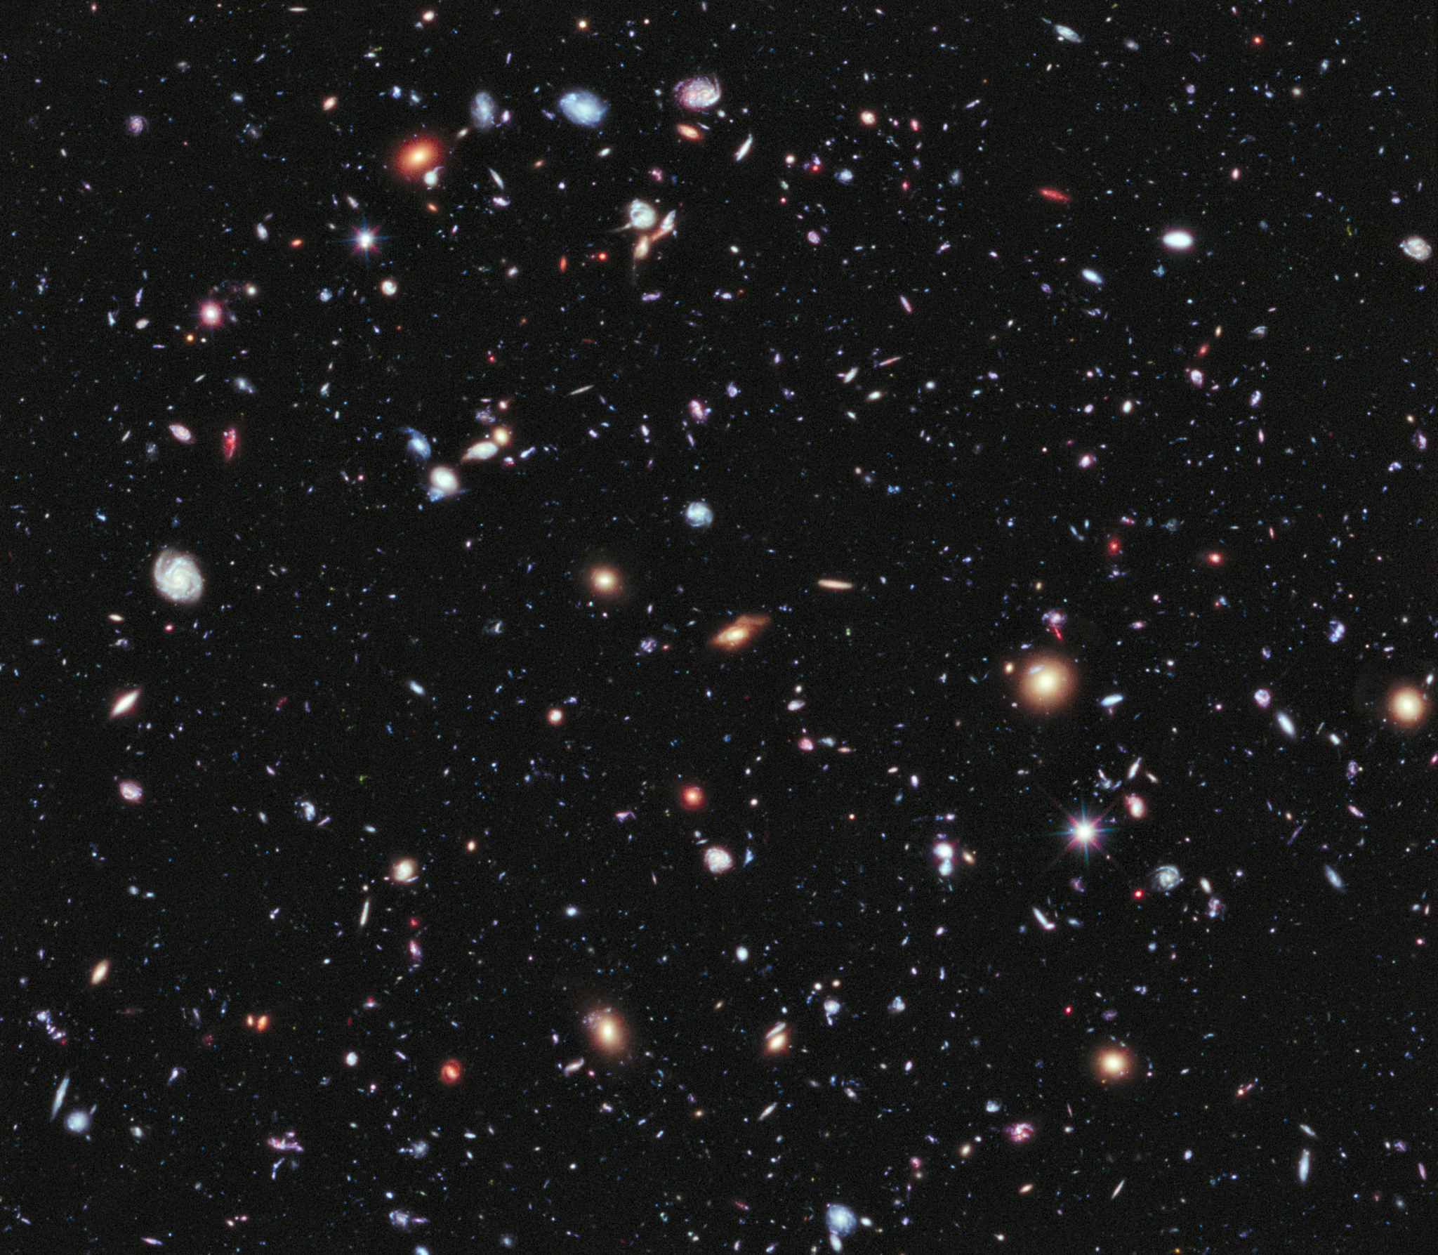
Future Work
Could include more bodies or consider non-circular orbits for further complexity and realism.
Make more sophisticated tides calculation

Slide 21
Acknowledgement
For animation code and template for the report: Department of SC/Physics. “L01 PHYS 2030”. PHYS2030 3.0 Computational Methods for Physicists and Engineers Course Lecture slides Winter 2023. York University 2023.

Slide 22
References
Values for mass, distances extracted from https://starwars.fandom.com/wiki/Endor
https://en.wikipedia.org/wiki/Orbit_of_the_Moon
https://en.wikipedia.org/wiki/Earth%27s_orbit
https://phys.org/news/2014-11-earth-orbit-sun.html
https://nssdc.gsfc.nasa.gov/planetary/factsheet/earthfact.html
https://science.nasa.gov/moon/tides/
https://www.physicsforums.com/threads/solar-vs-lunar-tides-explaining-the-difference.535403/

Slide 23
References
https://nssdc.gsfc.nasa.gov/planetary/factsheet/moonfact.html
https://moviepy.readthedocs.io/en/latest/getting_started/working_with_matplotlib.html
https://austides.com/wp-content/uploads/2014/06/Kowalik_Luick_2011.pdf
https://www.youtube.com/watch?v=pwChk4S99i4&t=423s
https://matplotlib.org/stable/gallery/mplot3d/surface3d_2.html#sphx-glr-gallery-mplot3d-surface3d-2-py
https://en.wikipedia.org/wiki/Tidal_range#/media/File:M2_tidal_constituent.jpg
Notes:
I hope you like our presentation, thank you for you attention.

Slide 24


